Slide 1
Building a Large Annotated Corpus of English: The Penn Treebank
Fangning Shao
Notes:
Hi everyone. I am Fangning.
The topic I am presenting today is Building a Large Annotated Corpus of English: The Penn Treebank.

Slide 2
What is Penn Treebank, and Why?
Corpus Linguistics: Use computers to help study and understand languages
Penn Treebank: pioneering Corpus Linguistics breakthrough:
1) Built large annotated corpus
2) Guiding future research
Notes:
This topic I choose is in Computational Linguistics field. It is a field to use computers to help study and understand languages.
For example, how to use a dataset in English language to analyze the usage of certain verbs, or even helping machines to make sense of human language nowadays.
Penn Treebank was really a pioneering research project in this field. The project built a large annotated corpus for future studies, and defined standard methods to guide future research, which I will discuss later.
I chose this corpus because it has been such an influential research project, and is still widely used by the academia today.

Slide 3
Penn Treebank Project - Overview
8 years of operation (1989-1996)
Size:
~7 million words of part-of-speech tagged text
~3 million words of parsed text
Materials:
IBM computer manuals, nursing notes, Wall Street Journal articles, transcribed telephone conversations, brown corpus (all US printed materials in 1961)...
Notes:
The Penn Treebank Project is an old project that begins 28 years ago. The whole project operated for 8 years, and when finished, it has about 7 million words of POS tagged text and 3 million words of parsed text. About what is pos tag and what is parse, I’ll talk about them later. The content of the corpus covers many different domains, such as IBM computer manuals, nursing notes, Wall Street journal articles, telephone calls, and the whole Brown corpus.

Slide 4
What Penn Treebank can help with
Natural Language Processing
Speech technology
Theoretical linguistics
Data processing companies
Notes:
Why did they build this annotated corpus? Such kind of large annotated corpus is an important tool for researchers in natural language processing, speech recognition, integrated spoken language systems, and also in theoretical linguistics. In fact, until today, it is still widely used by academic organizations and data processing companies.

Slide 5
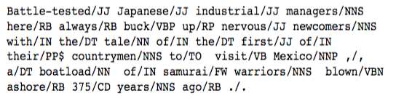
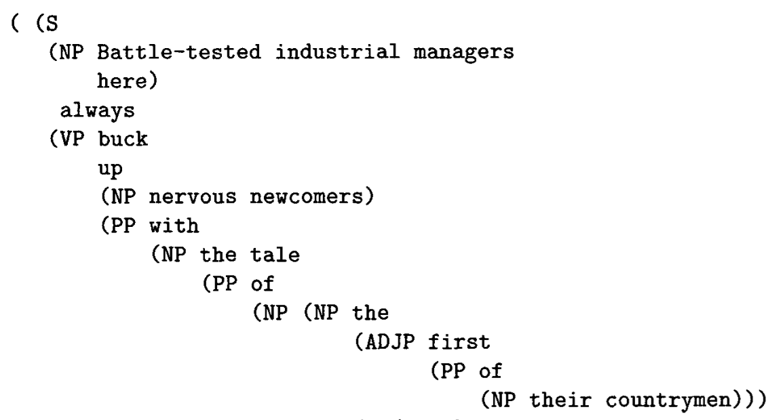
Penn Treebank: Two Phases
POS tagging
Syntactic bracketing
Notes:
The most important phases in this project are: the POS tagging task and the bracketing task. The size of the corpus may not seem very impressive today, because it is done 25 years ago.

Slide 6
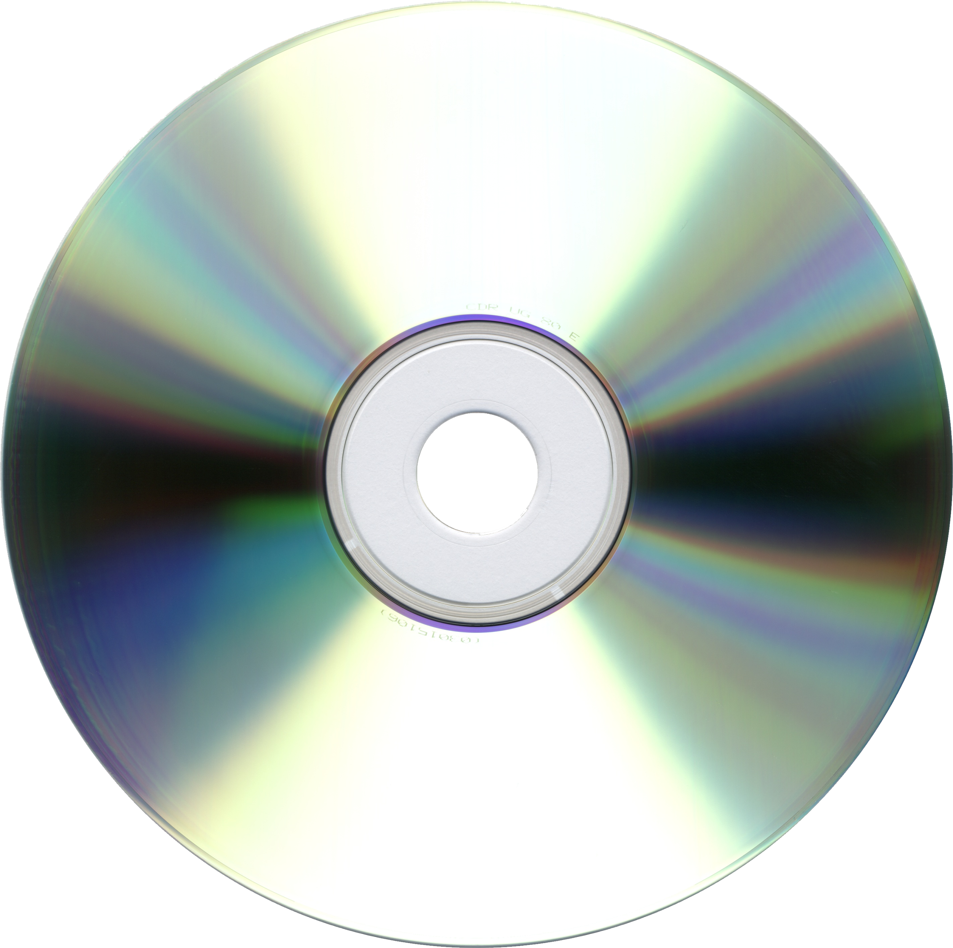
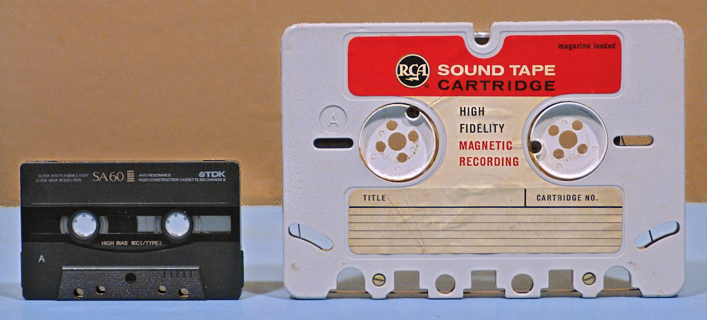
It's done 25 years ago...
Notes:
Actually, this corpus was originally saved into CDs and tapes!

Slide 7
The POS tagging task
POS tagging: word class markup
Notes:
Before the PTB project, the brown corpus, which was a pioneer in the annotated corpus field, built a set of 87 tags. And it also allowed compound tags, which made the total number of tags 187. The Lancaster corpus, which even elaborated the brown corpus tagset, used 135 tags. Why are there so many tags? The ideal of the POS tagset is to have different tags for every word class which has distinct grammatical behavior. Therefore, we need much more tags than just noun, verb, or adposition.

Slide 8
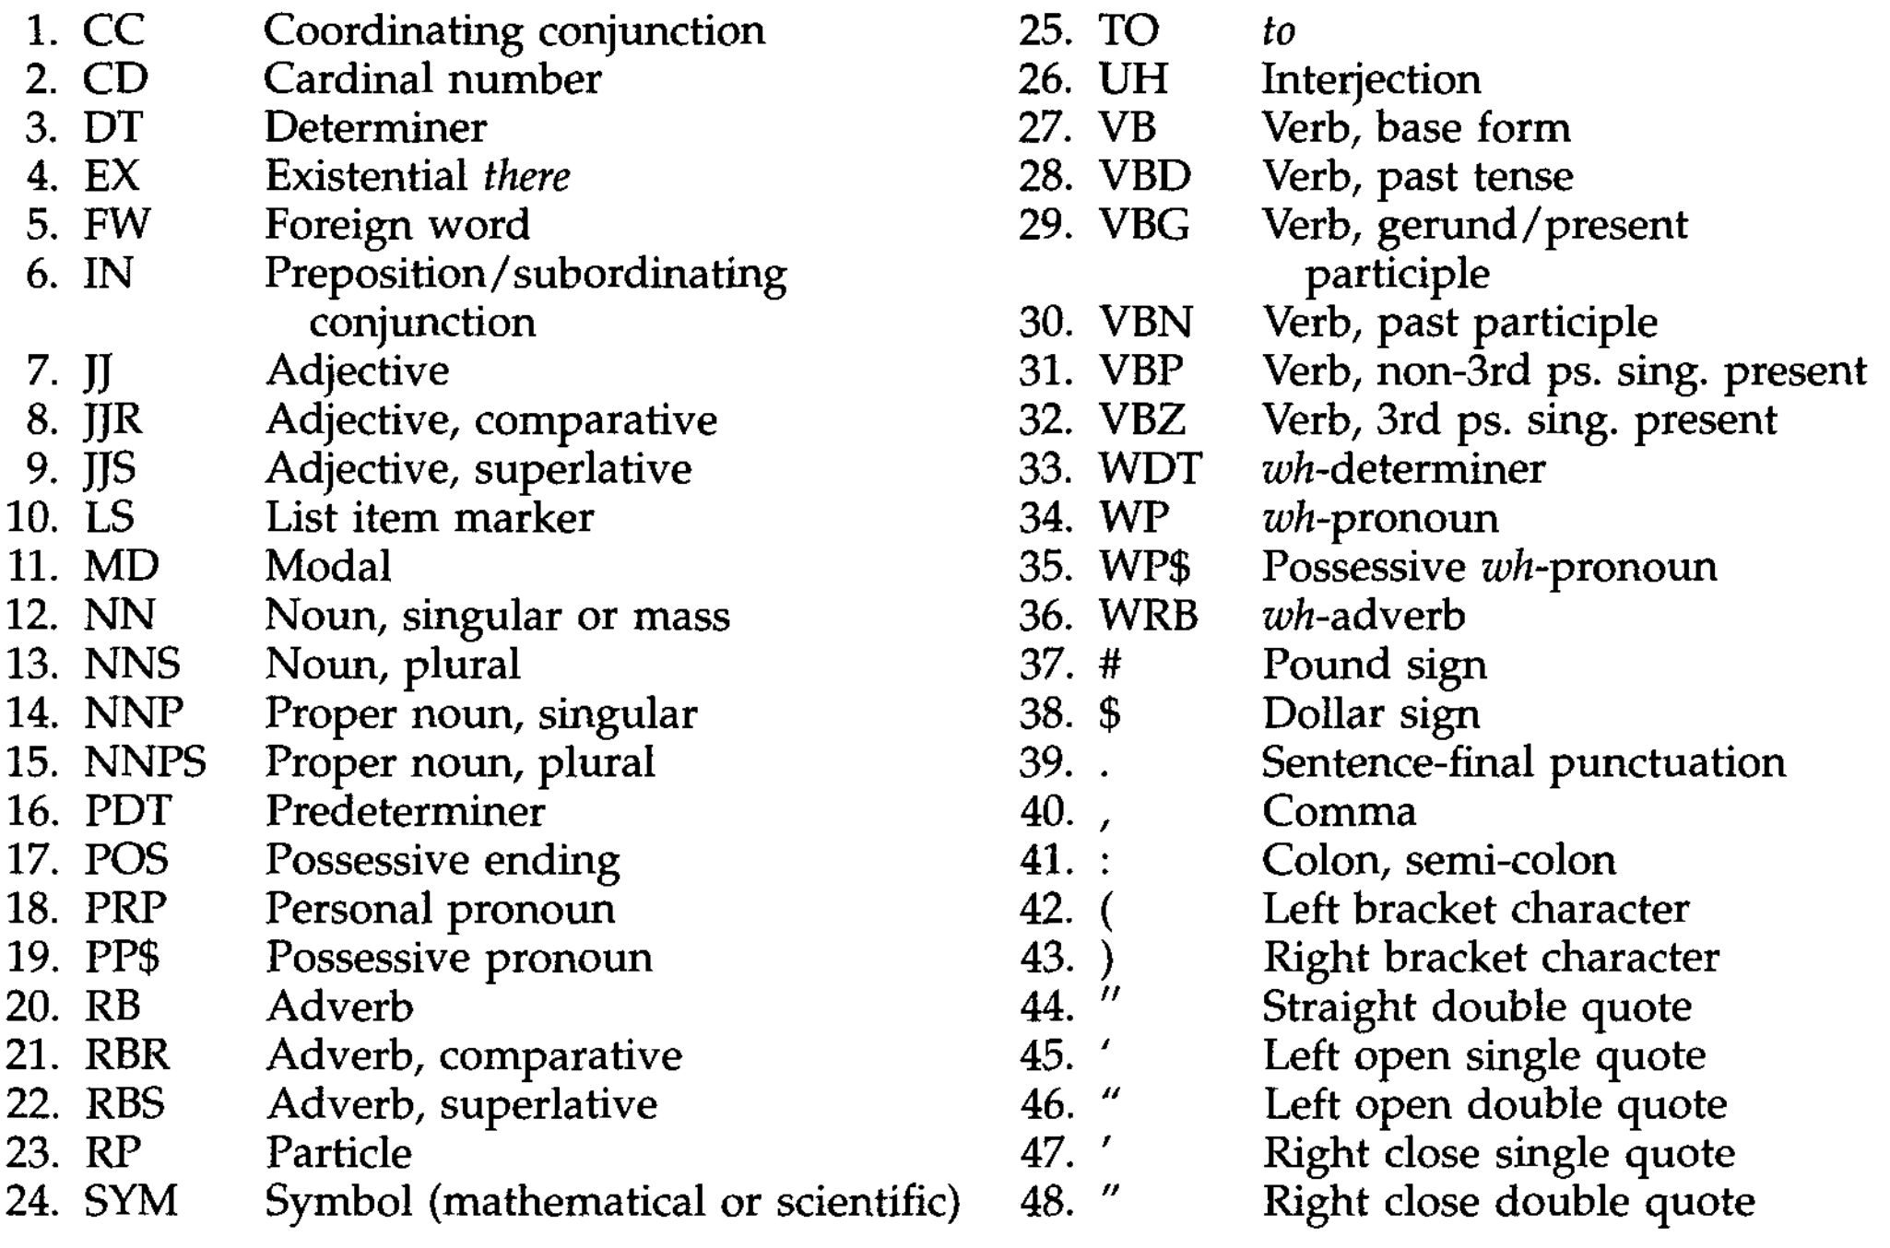
Penn Treebank POS Tagset
Notes:
The Penn Treebank team simplified their tagset on the base of the Brown corpus tagset. They only have 48 tags. Despite the decrease in number, the Penn Treebank tagset is still a richly articulated tagset which can be fully recovered into Brown tagset without losing any information.

Slide 9


Tagging: Two options
Battle-tested industrial managers here always buck up...
Battle-tested/JJ industrial/JJ managers/NNS here/RB always/RB buck/VBP up/...
1. Manual Tagging (slow, unstable)
2. Automated tagging
(inaccurate)
O_O
Notes:
Now we have a complete tagset and a large corpus, how can we annotate these tags on each word? 25 years ago, they had two choices: first is to do it manually, purely by human. But this is such a large corpus -- people get tired, people make mistakes, and it would take forever. The second choice was to use automatic taggers. However, in that age, automatic taggers suffered from a relatively high error rate. The genius in PTB team thought of a wonderful idea. Can you guess what it is?

Slide 10
Method: semi-automated tagging
Battle-tested industrial managers here always buck up...
Error rate:
7-9%
Battle-tested/NNP industrial/JJ managers/NNS here/RB always/RB buck/VB up/...
Error rate after correction: 3.4%
Battle-tested/NNP*/JJ industrial/JJ managers/NNS here/RB always/RB buck/VB*/VBP up/...
Automated
Stage
Correction
Stage
PARTS
Overall accuracy: 96.6%
Notes:
Yes, combine them! The team used a tagger called PARTS developed by AT&T Bell Labs. PARTS used a modified version of the Brown tagset. The team then mapped the output onto PTB tagset. The error rate at this stage is 7-9% percent. After the automated stage, the result is given to annotators to correct. After manual correction, the error rate is reduced to 3.4%, which makes overall accuracy 96.6% which is very impressive. In fact, the best modern automatic POS taggers still has slightly over 97% accuracy.

Slide 11
Semi-automated vs Manual
Semi-automated approach is superior to manual tagging in:
Speed
Accuracy
Consistency
Notes:
The PTB team did do an experiment between full manual tagging and this combined method on a sample. The latter is shown to be better on speed, accuracy and consistency.

Slide 12
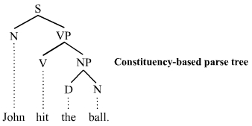
Bracketing (parsing): syntactic annotation
Parsing: break sentence into constituents, and mark the hierarchy between them
Example: “John hit the ball.”
(S John (VP hit (NP the ball) ) )
Notes:
The second phase of the project is bracketing, also known as syntactic parsing.
Parsing is basically (SEE SLIDE), and here is a simple visual example of a parsed sentence. Bracketing is essentially the process of determining the parse tree.

Slide 13
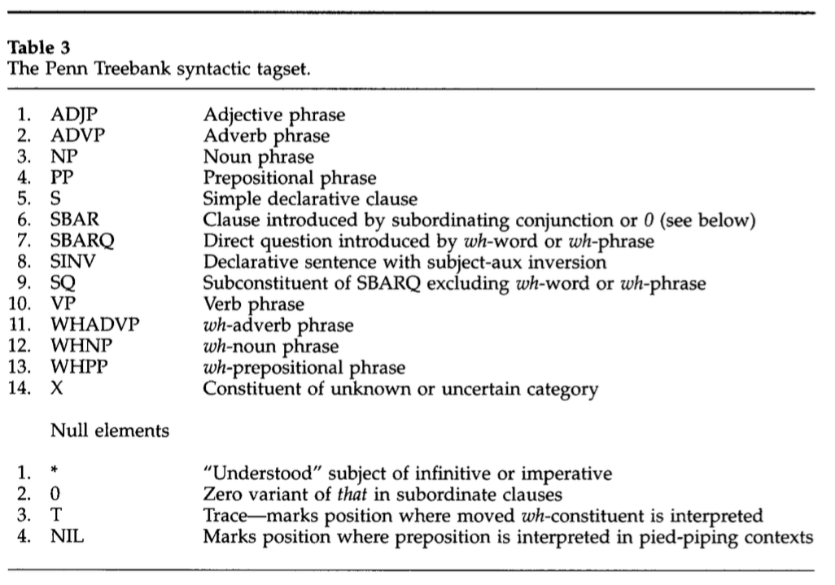
Parsing Tagset
Notes:
Here is the tagset that the Penn Treebank team built for bracketing.

Slide 14
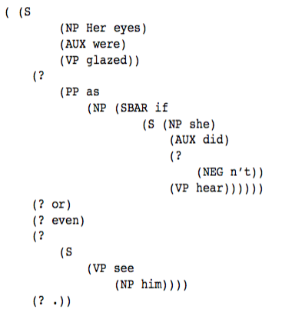
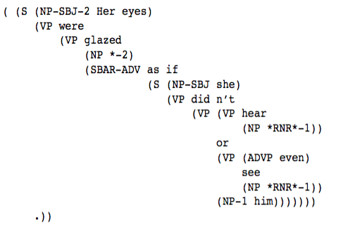
Semi-automated Bracketing
Fidditch Output
After Manual Correction
Correction
Notes:
The methodology of the bracketing task is completely parallel to the POS tagging task: first automatic process, then hand-correction. The automatic parser they used is developed by Bell Labs as well. It's called Fidditch.
Fidditch is a deterministic parser, which means that it always gives exactly one analysis for any given sentence. Fidditch has another property: when it cannot determine the rule of a constituent, it never marks it up. It is possible that after Fidditch processes the text, only partial structure of the sentence is annotated. These two properties make it probably the best choice that time as a pre-processing tool before manual correction.

Slide 15

Annotators: the anonymous heroes
Notes:
The project published papers to introduce how they trained their annotators, and how they changed the automatic processor to suite manual correction. Nowadays, academic organizations and tech companies use a lot of crowd labeling services such as Mechanical Turk and CrowdFlower to do the manual correction. But in 1990s, there were not such services on the market yet. So the PTB team hired some linguists to be the annotators. All the annotators had graduate-level training in Linguistics to qualify these tasks.
These annotators were the anonymous heroes that pushed technology to advance.

Slide 16
Annotators: learning curve in two tasks (rough)
Linguists with graduate-level education
POS tagging Bracketing
words per hour
words per hour
3,000
1,000
1 mo
3-4 mo
Notes:
Annotation tasks do require a lot of training. For POS tagging, the learning curve takes under a month at 15 hours a week, and the annotation speed after a month 3,000 words per hour. For bracketing, the annotators take substantially longer to learn than tagging. They had substantial increases in speed even after 2 months of training. The performance for bracketing varied a lot by person. The speed ranged from ~750 to ~1000 words per hour after 3-4 months of experience. It is worth noting that experienced annotators can proof-read previously corrected materials at very high speed. By very high, I mean, an average speed of 4,000 words per hour with a mouse-based interface. Nowadays...

Slide 17
Contributions
Simplified POS Tagset up to modern standards
Annotated corpus helped training state-of-the-art taggers and parsers
Novel semi-automated methodology for annotation
Pioneering in studies in human annotation
Notes:
In summary, PTB project laid an important foundation of computational linguistics over 25 years ago. The POS tagset is still used as modern standards. The annotated corpus helped training state-of-the-art modern taggers and parsers. The semi-automated annotation method is still popular by now. The studies in human annotations has implications for effective annotation tasks today. Overall, PTB is a very influential research project in computational linguistics.

Slide 18
Reference
Marcus, Mitchell P., Mary Ann Marcinkiewicz, and Beatrice Santorini. "Building a large annotated corpus of English: The Penn Treebank." Computational linguistics 19.2 (1993): 313-330.
Taylor, Ann, Mitchell Marcus, and Beatrice Santorini. "The Penn treebank: an overview." Treebanks. Springer Netherlands, 2003. 5-22.
Manning, Christopher. "Part-of-speech tagging from 97% to 100%: is it time for some linguistics?." Computational Linguistics and Intelligent Text Processing (2011): 171-189.
Notes:
And here are some of my references.

Slide 19

Thanks!
Questions?
Notes:
That's all for my presentation. Thanks for your attention! Any questions?

